Slide 1

IPL Auction

Slide 2
Create Tables
create table matches(id integer,season integer, city varchar,date date, team1 varchar, team2 varchar, toss_winner varchar, toss_decision varchar, result varchar, dl_applied integer,winner varchar, win_by_runs integer, win_by_wickets integer, player_of_match varchar, venue varchar, umpire1 varchar, umpire2 varchar, umpire3 varchar);
create table deliveries (match_id integer, inning integer, batting_team varchar, bowling_team varchar, over integer, ball integer, batsman varchar,non_striker varchar, bowler varchar,is_super_over integer, wide_runs integer, bye_runs integer, legbye_runs integer, noball_runs integer,penalty_runs integer, batsman_runs integer, extra_runs integer,total_runs integer, player_dismissed varchar, dismissal_kind varchar,fielder varchar);

Slide 3
Copy Data to Tables
copy deliveries from 'C:\archana\internshala\sql\eda_ipl-main\deliveries.csv' with (format 'csv', header true);
copy matches from 'C:\archana\internshala\sql\eda_ipl-main\matches.csv' with (format 'csv', header true);

Slide 4
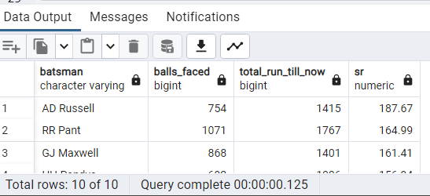
1.Batsman with high striking rate
select *,round((total_run_till_now * 1.0/balls_faced)*100,2) as SR from (select batsman,count(*) as balls_faced, sum(batsman_runs) as total_run_till_now from deliveries where wide_runs=0
group by batsman ) where balls_faced>=500 order by SR desc limit 10;

Slide 5
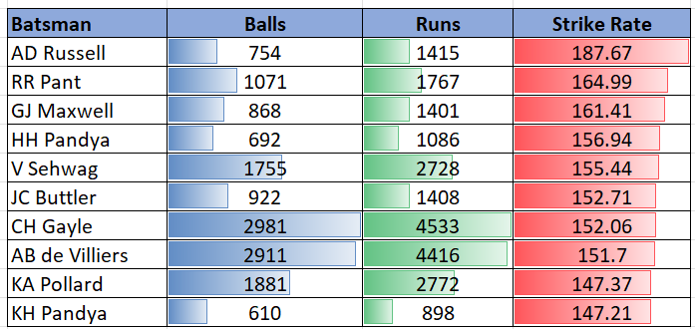

Slide 6
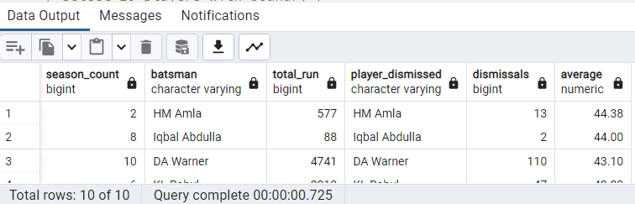
2. Batsman with High Average
select *,round(a.total_run *1.0/dismissals,2) as average from (select count(distinct season ) as season_count,batsman,sum(batsman_runs)as total_run from (select match_id, season,batsman, batsman_runs from deliveries inner join matches on match_id=id)group by batsman) as a inner join
(select distinct player_dismissed, count(player_dismissed)as dismissals from deliveries group by player_dismissed) as b
on a.batsman=b.player_dismissed where season_count>=2 order by average desc limit 10

Slide 7
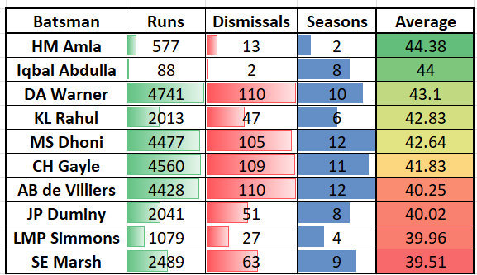

Slide 8
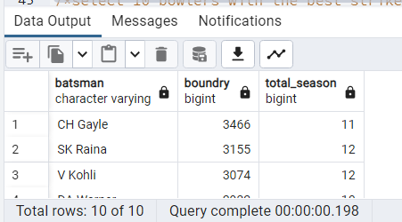
3. Batsman with Max Boundary
select * from (select batsman, sum(batsman_runs) as boundry,count(distinct season) as total_season
from (select a.*,b.* from deliveries as a inner join matches as b
on a.match_id=b.id)where batsman_runs>=4 group by batsman )where total_season>=2 order by boundry desc limit 10;

Slide 9
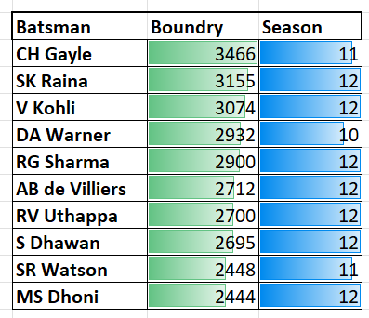

Slide 10
4.Economy Bowlers
select * ,round(runs_given * 1.0/total_ball/6,2) as economy_rate from (select bowler as economy_bowler, sum(total_runs) as runs_given,count(*) as total_ball from deliveries group by bowler) where total_ball>=500 order by economy_rate asc limit 10

Slide 11
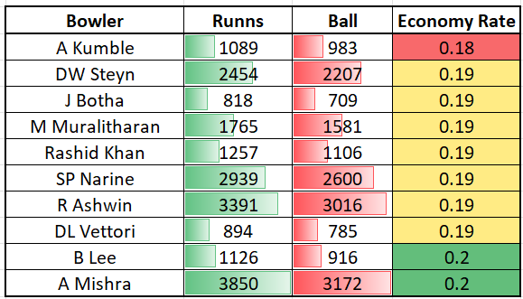

Slide 12
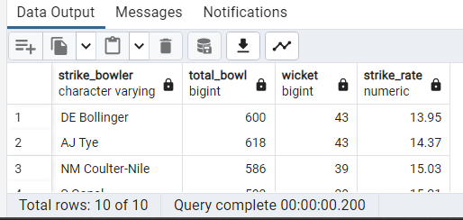
5.Striker Bowler
select *,round(total_bowl*1.0/wicket,2) as strike_rate from (select bowler as strike_bowler,count(*)as total_bowl,
count (case when player_dismissed is not null then 1 end) as wicket from deliveries group by bowler)
where total_bowl>=500 order by strike_rate asc limit 10;

Slide 13
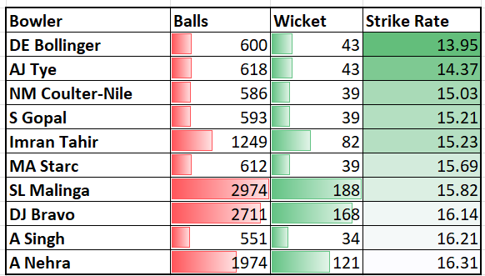

Slide 14
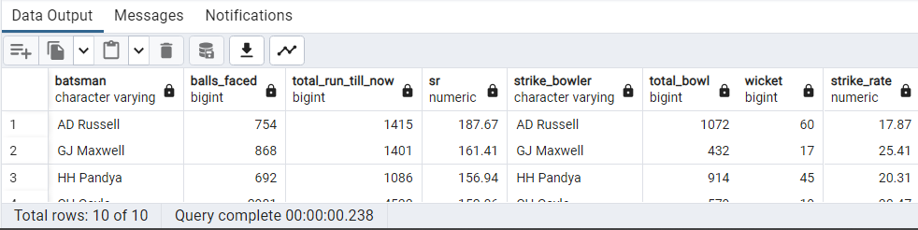
6. All Rounders
select a.*,b.* from (select *,round((total_run_till_now * 1.0/balls_faced)*100,2) as SR from (select batsman,count(*) as balls_faced, sum(batsman_runs) as total_run_till_now from deliveries where wide_runs=0 group by batsman ) where balls_faced>=500) as a inner join
(select *,round(total_bowl*1.0/wicket,2) as strike_rate from (select bowler as strike_bowler,count(*)as total_bowl, count (case when player_dismissed is not null then 1 end) as wicket from deliveries group by bowler) where total_bowl>=300) as b on a.batsman=b.strike_bowler order by SR desc , strike_rate desc limit 10;

Slide 16
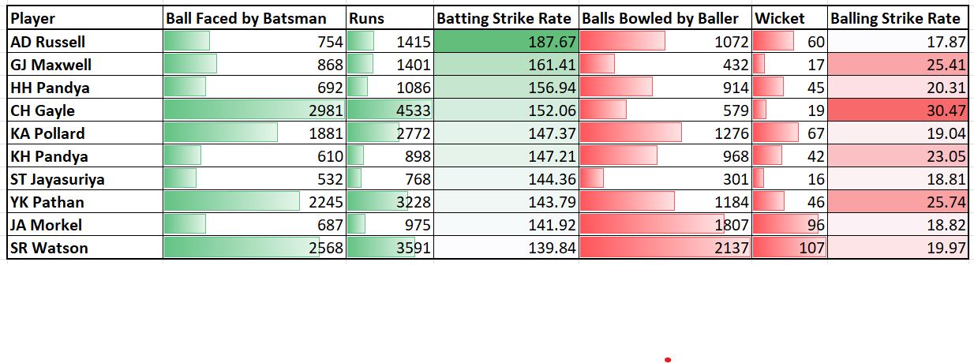

Slide 17
7. Criterion for Wicketkeeper
1. Players must have caught the highest number of catches over all the matches played by him
2. Average batting strike rate of all matches played by player should be higher (Here we need to calculate strike rate of each player for each match based on balls bowled to the player and runs scored by player and then take average of it)
3. Average balling strike rate of all matches played by player should be higher (Here we need to calculate strike rate of each player for each match based on balls bowled to the player and runs scored by player and then take average of it)
By comparing players in the list with above three criterion best two wicket keepers can be identified.
Reasons are discussed in the next slide

Slide 18
Reasons of Wicketkeeper Criterion
wicketkeeper are responsible for catching and stumping the batsman
criterion 1 and 3 mentioned in the previous slide ensures above quality of the wicketkeeper
wicketkeeper is often expected to contribute to the team's run total with aggressive batting.
criterion 2 mentioned in the previous slide ensures this quality in wicketkeeper
They may also be called upon to bowl a few overs of spin or medium pace
criterion 2 mentioned in the earlier slide ensures this quality in wicketkeeper

Slide 19
Query 1&2
/*1 Get the count of cities that have hosted an IPL match*/
select count(distinct city) from matches as Total_city;
/*2 Create table deliveries_v02 with all the columns of the table ‘deliveries’ and an additional column ball_result containing values boundary, dot or other depending on the total_run (boundary for >= 4, dot for 0 and other for any other number)*/
create table deliveries_v02 as (select * ,case when total_runs>=4 then 'boundry'
when total_runs=0 then 'dot'
else 'other'
end as ball_result from deliveries ) ;

Slide 20
Query 3&4
/*3.Write a query to fetch the total number of boundaries and dot balls from the deliveries_v02 table.*/
select * from (select count(*) as boundry_balls from deliveries_v02 where ball_result in ('boundry')) cross join (select count(*) as boundry_balls from deliveries_v02 where ball_result in ('dot’)) ;
/*4.Write a query to fetch the total number of boundaries scored by each team from the deliveries_v02 table and order it in descending order of the number of boundaries scored.*/
select batting_team, count(ball_result)as Total_boundry from deliveries_v02 where ball_result = 'boundry’ group by batting_team order by Total_boundry desc;

Slide 21
Query 5&6
/*5. Write a query to fetch the total number of dot balls bowled by each team and order it in descending order of the total number of dot balls bowled.*/
select bowling_team, count(ball_result)as dot_balls_bowled from deliveries_v02 where ball_result = 'dot’ group by bowling_team order by dot_balls_bowled desc;
/*6.Write a query to fetch the total number of dismissals by dismissal kinds where dismissal kind is not NA*/
select count(player_dismissed) from deliveries_v02 where player_dismissed is not null and dismissal_kind is null;

Slide 22
Query 7&8
/*7 Write a query to get the top 5 bowlers who conceded maximum extra runs from the deliveries table*/
select bowler, sum(extra_runs) as total_extra_run from deliveries_v02 group by bowler order by total_extra_run desc ;
/*8 Write a query to create a table named deliveries_v03 with all the columns of deliveries_v02 table and two additional column (named venue and match_date) of venue and date from table matches*/
create table deliveries_v03 as (select a.*,b.venue, b.date from deliveries_v02 as a
left join matches as b on a.match_id=b.id );

Slide 23
Query 9&10
/*9.Write a query to fetch the total runs scored for each venue and order it in the descending order of total runs scored.*/
select sum(total_runs)as total_runs_scored from deliveries_v03 group by venue order by total_runs_scored desc ;
/*10. Write a query to fetch the year-wise total runs scored at Eden Gardens and order it in the descending order of total runs scored.*/
select sum(total_runs)as total_runs_scored, extract(year from date) as season from deliveries_v03 where venue= 'Eden Gardens' group by season ;

